Slide 1
Lending Club Case Group Study
Prepared by
Prashant Tariwal
Rajesh Balakrishnan

Slide 2
Objective
Understand how data is used to minimize the risk of losing money while lending to customers by using Exploratory Data Analysis.
Observation
Two types of risks are with the bank’s decision.
If the applicant is likely to repay the loan, then not approving the loan results in a loss of business to the company.
If the applicant is not likely to repay the loan, i.e. he/she is likely to default, then approving the loan may lead to a financial loss for the company.
Two types of Data sets.
Loan accepted: If the company approves the loan, there are 3 possible scenarios described below:
Fully paid : Applicant has fully paid the loan (the principal and the interest rate)
Current : Applicant is in the process of paying the instalments, i.e. the tenure of the loan is not yet completed. These candidates are not labelled as 'defaulted'.
Charged-off : Applicant has not paid the instalments in due time for a long period of time, i.e. he/she has defaulted on the loan.
Loan rejected: If company not approved the loan because of not meeting the requirement's of the bank rules.

Slide 3
Summary
Univariate Analysis
Positive Correlation with loan_amount, funded_amount, funded_amount_inv and installment.
Interest rate is higher, the chance for 'charged off' is more.
Loan amount is increasing, there is a high probability of loan getting default.
Higher the repayment term chances of charge off will be higher.
Lower grades company default rate is much higher than others.
Loan for small_business, renewable_energy and educational are the riskier ones.
The presence of specific celebrations can be the reason for more charge off 7th & 11th Months.
Bivariate Analysis
Higher installments for any income group have more number of defaults.
As the interest rate and Loan term increases the chance of charged off is more.
As the debt increases the chance to be default is getting increased
Conclusion
Providing the loan to higher grade company employees.
Less loan amount and less interest increase the less Charge off.
Higher annual income lesser the charge off so provide the loan to higher income employees.
Providing the cc loans its helps to when customer is doing Charge off so we can cut the loan from cc account so its very help full and customer can enjoy holidays and celebration without any guilty and loan pressure.

Slide 4
Steps followed for the case study
Step 1: Data Understanding
Understanding the every column and its significant in the analysis.
Step 2: Data Cleaning
Removing the unwanted rows and columns after understanding the importance of that.
Step 2: Univariate Analysis
By using the every column analyzing the risk factors of the Charged off % and fully paid%.
Step 3: Segmented Univariate Analysis
By using single and multi column we are going to analyzing the risk factors of the Charged off % and fully paid% by clustering the data. Ex : Purpose of loan, Month, occupation, Company grade and state wise.
Step 4: Bivariate Analysis
By using multi column we are going to analyzing the risk factors of the Charged off % and fully paid% by clustering the data. Ex : Purpose of loan, Month, occupation, Company grade and state wise.
Step 5: Recommendations/Results
To reduce the risk factor and the importance of the business we are going to give recommendations and explain the result

Slide 5
Data Cleaning Steps
Delete columns: Delete unnecessary columns.
Remove outliers: Remove high and low values that would disproportionately affect the results of our analysis.
Missing values: Treat missing values with appropriate approach.
Duplicate data: Remove identical rows, remove rows where some columns are identical.
Filter rows: Filter by segment to get only the rows relevant to the analysis.
Analysis
The whole project is to analyze and understand how consumer and loan attributes are influencing the tendency of Charge off.
During analysis used the different plots.
○ Histograms and Bar charts to check out the distribution of all the variables
○ Box plots to detect the Outliers
○ Performed the Bivariate analysis to understand how different variables interact with each other and how its affecting the Charge off% and fully paid%.

Slide 6
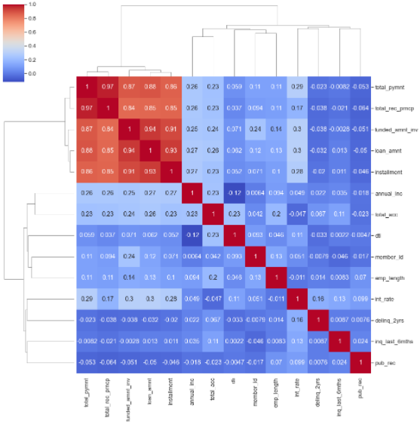
Univariate Analysis
Let us visualize the data in a Heat Map
We have Positive Correlation Among Below Values.
loan_amount, funded_amount, funded_amount_inv and installment
public records related fields pub_rec & pub_rec_bankrupcies and number of accounts related fields open_acc & total_acc are correlated

Slide 7
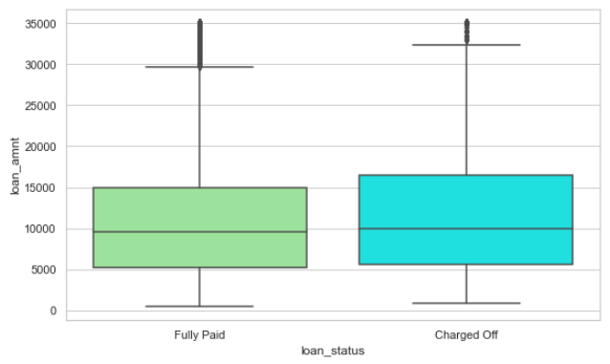
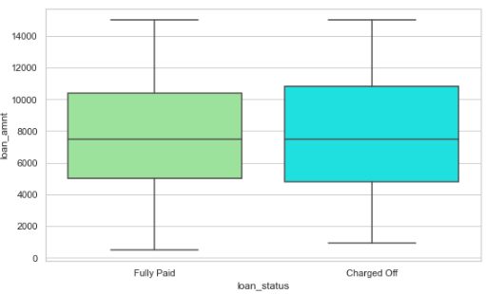
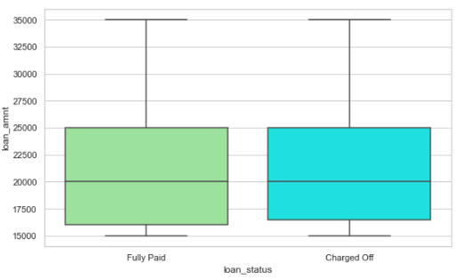
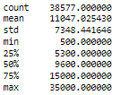
Univariate Analysis
Loan amount took min to max for analysis
Loan amount took min to 75% for analysis
Loan amount took 75% to Max for analysis
There is no clear correlation between loan_status, loan_amount, there is some outliers in loan amount
since it is giving picture , let us take date data above 75%
From above box plot we are not considering that "higher the amount" as it is insignificant

Slide 8
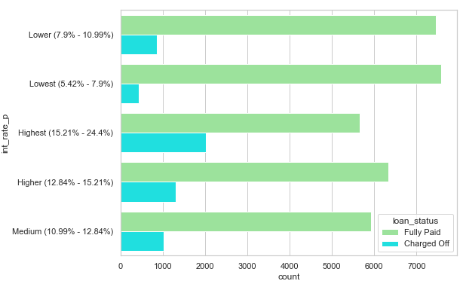
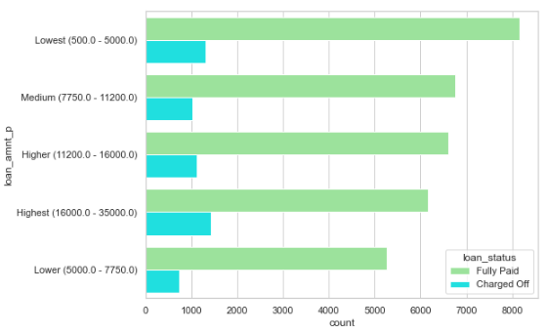
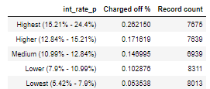
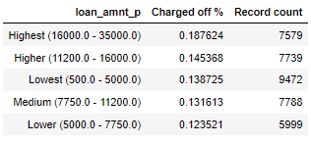
Univariate Segment Analysis
Interest rate and count is Correlation with Loan status
Loan amount and count is Correlation with Loan status
If the interest rate is higher, the chance for 'charged off' is more
If the loan amount is increasing, there is a high probability of loan getting default.

Slide 9
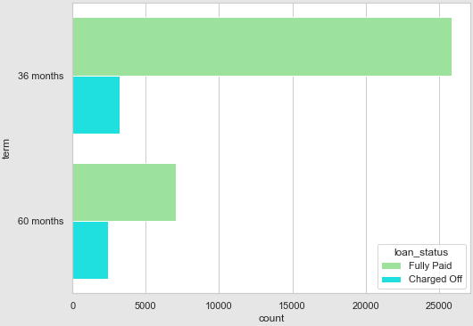
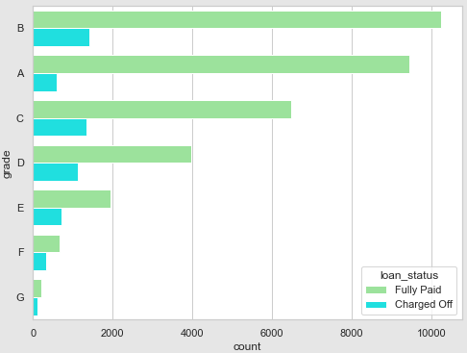

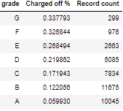
Univariate Segment Analysis
Loan term and count is Correlation with Loan status
Company grade and count is Correlation with Loan status
We can clearly see that loan grades having highest default percentages. G, F, E and D form grades where default rate is much higher than others
For loans with 60 months term the default percent is 25%. and for 36 months term the default is only for 11% of the cases. If higher the repayment term chances of charge off will be higher

Slide 10
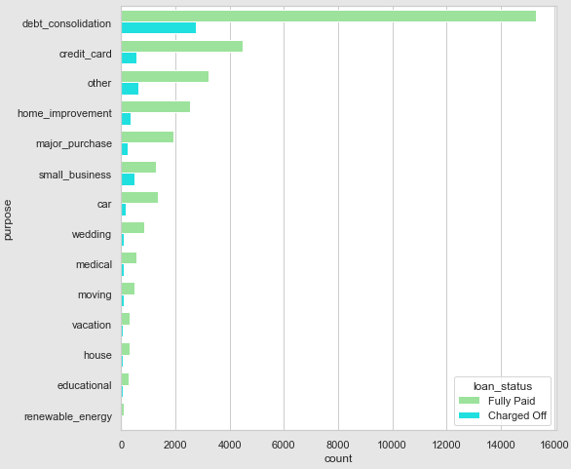
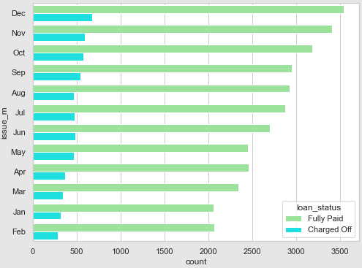
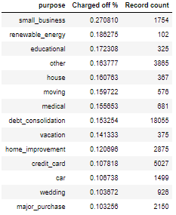
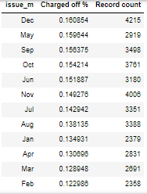
Univariate Segment Analysis
Purpose of loan and count is Correlation with Loan status
Loan issue month and count is Correlation with Loan status
The plot shown loan for small_business, renewable_energy and educational are the riskier ones
The presence of specific celebrations can be the reason for more charge of 7th & 11th Months

Slide 11
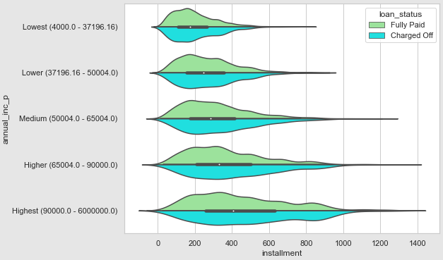
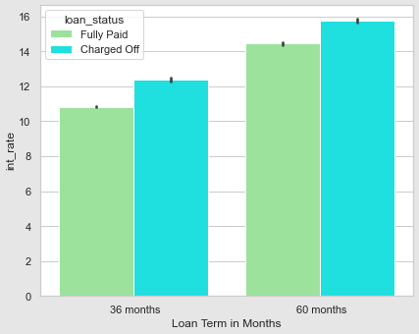
Bivariate Analysis
Annual income and installment Correlation with Loan status
Interest rate and Loan term is Correlation with Loan status
The Graphs is quite revealing the fact that shows that for higher installments for any income group have more number of defaults.
As the interest rate and Loan term increases the chance of charged off is more

Slide 12
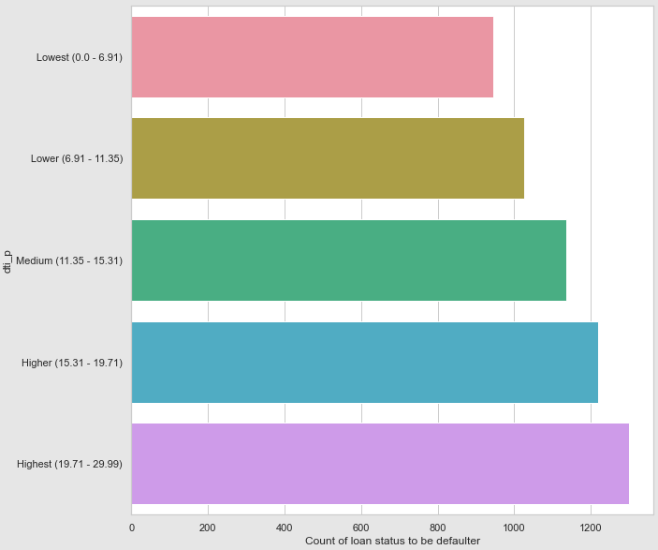
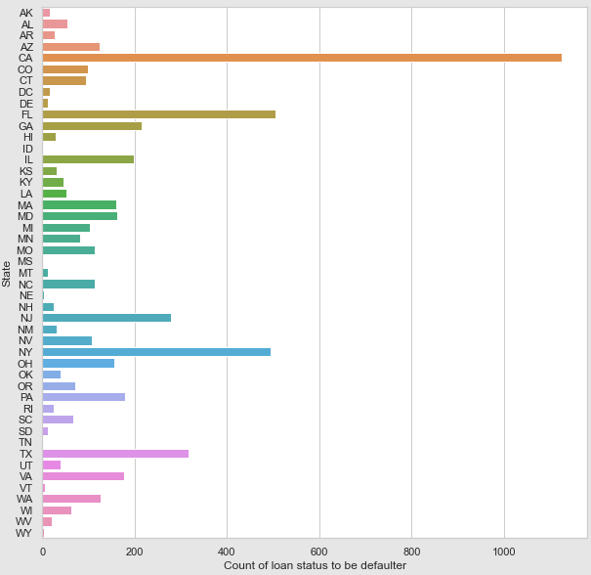
Bivariate Analysis
DTI and Loan status correlations
Interest rate and Loan term is Correlation with Loan status
As the debt increases the chance to be default is getting increased
There is a combined effect in case of the loan charged off VS Resident Area

Slide 13
Thank you

